Slide 1

Fake Product Review Detection
Shreyas Mhatre 23106135
Parth Shah 23106087
Krish Sharma 23106115
Varun Panchal 23106050
Project Guide
Ms. Tejashri Kolhe
2024-25
Notes:
1

Slide 2
Introduction
Problem Statement -
Online reviews influence consumer decisions but are often
manipulated using AI-generated or fake reviews.
Fake reviews mislead buyers, distort competition, and reduce trust in e-commerce platforms.
Existing detection methods struggle with evolving fraudulent tactics.
Notes:
2

Slide 3
Motivation –
Consumers unknowingly rely on misleading reviews.
Existing solutions lack transparency and are resource-intensive.
AI-generated reviews make traditional detection methods less effective.
Need for a lightweight, locally running detection system.
Objectives -
Develop a locally running fake review detection system using LLM via Olama.
Evaluate AI models for detecting fake and AI-generated reviews.
Ensure privacy, efficiency, and real-time detection without cloud dependency.
Notes:
3

Slide 4
Literature Survey of the Existing System
Introduction -
The detection of fake product reviews has become crucial due to the influence of online reviews on consumer behavior. Researchers have approached this problem using machine learning, deep learning, and NLP methods, each
contributing novel insights.
Survey of Existing Work -
Nitin Jindal and Bing Liu (2008) Paper: Opinion Spam and Analysis Summary: This early work categorized fake reviews into types such as untruthful and promotional spam. They used logistic regression models with features like review burstiness and rating deviation to detect opinion spam on e-commerce platforms.

Slide 5
Myle Ott, Yejin Choi, Claire Cardie, and Jeffrey T. Hancock (2011) Paper: Finding Deceptive Opinion Spam by Any Stretch of the Imagination Summary: Introduced a gold-standard dataset of truthful and deceptive hotel reviews. Used supervised learning methods, particularly SVMs with unigram and POS-tag-based features, achieving high accuracy in detecting deceptive reviews.
Arjun Mukherjee, Abhinav Kumar, Bing Liu, Natalie Glance (2013) Paper: Fake Review Detection: Classification and Analysis of Real and Pseudo Reviews Summary: Focused on Yelp data, incorporating behavioral footprints like review timelines, user activity, and review burst patterns, and proposed models that combine behavioral and textual features for higher accuracy.
Current Challenges
Insufficient cross-domain datasets.
Emerging threat of AI-generated fake reviews.
Lack of interpretability in deep learning models.

Slide 6
Problem statement
Online reviews influence consumer decisions.
AI-generated and fake reviews reduce review reliability.
Fake reviews mislead buyers, boost ratings unfairly, and harm competitors.
Current detection methods (rule-based, ML) struggle with evolving fraud techniques.
These methods need large datasets, heavy computation, and cloud services, limiting real-time use.
The project aims to build a local fake review detector using a pre-trained LLM via Olama.
Focus on local analysis without cloud dependency.
Key challenges: accuracy, interpretability, and efficiency in a local setup.
Future scope: model fine-tuning and user feedback integration.

Slide 7
Overview of System Design
Input: User pastes a product review into a text box.
Processing:
Review is sent to a local AI model (Ollama) via an API call.
Model analyzes the review to determine if it’s fake or AI-generated.
Output: Displays results indicating if the review is genuine or fake.
Notes:
7

Slide 8
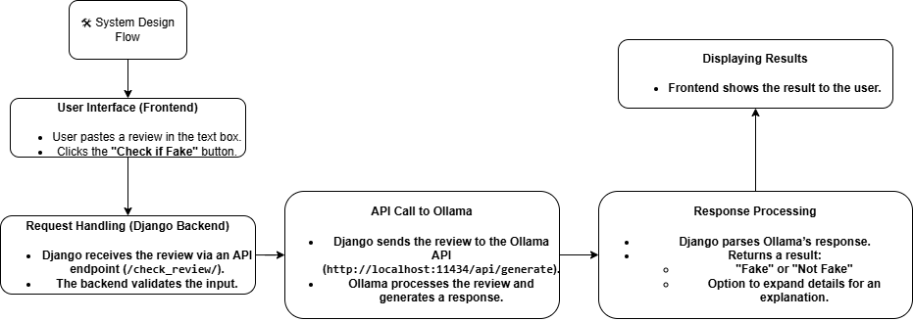
System Design
Notes:
8

Slide 9
Technology Stack
Programming Language: Python
Framework: Flask (Web-based application), html, css, js
Model: Ollama locally hosted AI model running on GPU
Hosting: Localhost or internal network for demonstration
Optional: Dataset from Kaggle or open-source repositories (if applicable).
Notes:
9

Slide 10
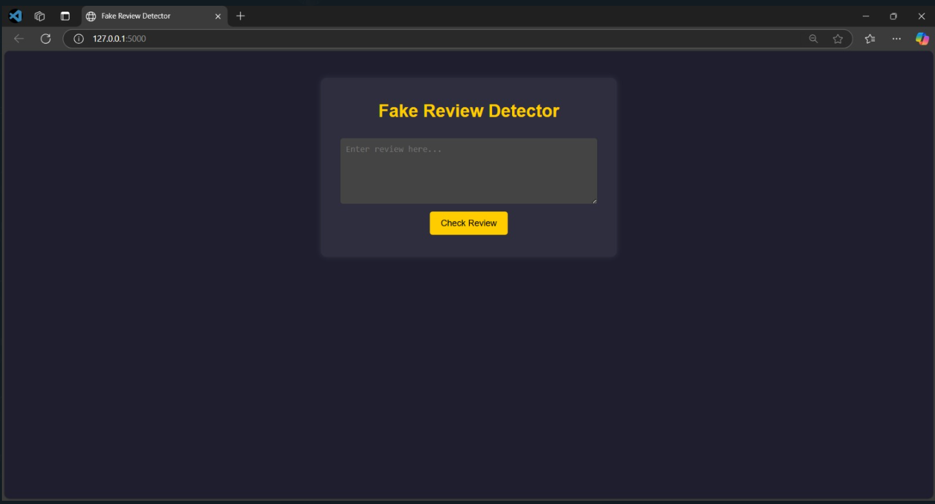
Implementation of Front End
Notes:
10

Slide 11
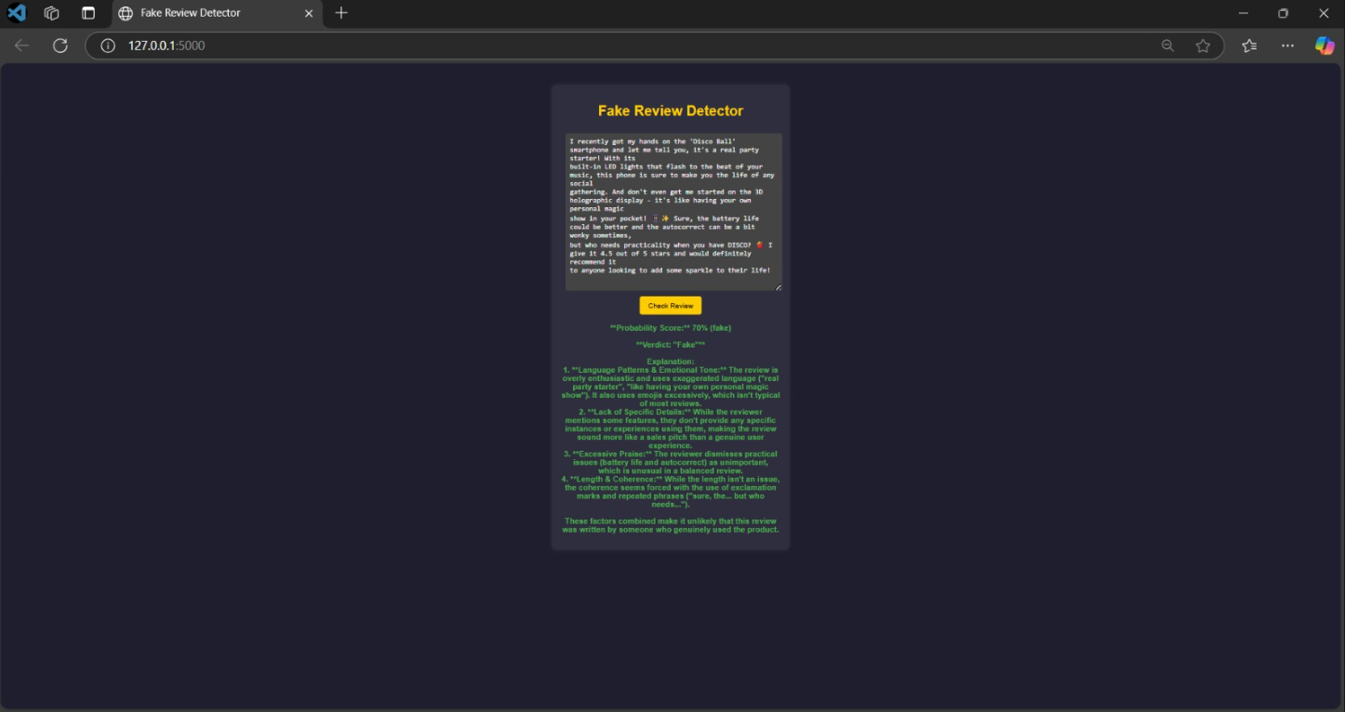
Result after fetching input/review
Notes:
11

Slide 12
Conclusion
Detecting fake reviews is key to trust in e-commerce.
AI-generated fraud is outpacing traditional detection.
Solutions involve:
Machine Learning (ML)
Natural Language Processing (NLP)
Markov Random Fields (MRF)
Goals: higher accuracy, better interpretability, and efficiency.
Focus on scalable, real-time, offline-capable systems.
Advancements will boost review reliability and trust for users and businesses.

Slide 13
References
Santhosh Krishna et al. https://link.springer.com/chapter/10.1007/978-3-031-45124-9_16
Puvana Devi C. et al. https://www.irjmets.com/uploadedfiles/paper/issue_3_march_2023/35073/final/fin_irjmets1680182289.pdf
Rami Mohawesh et al. https://arxiv.org/abs/2112.14343
Zhuo Wang et al. Link - https://arxiv.org/abs/1911.01690
Felix Soldner et al. https://arxiv.org/abs/2110.15130

Slide 14
Thank You...!!
Notes:
14

